Slide 1
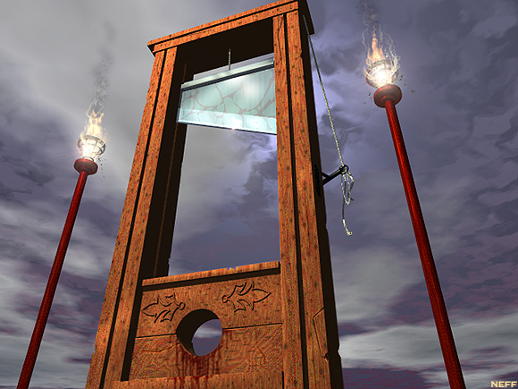
Why does today matter?
Radical Days and the Reign of Terror 1792-1795
Robespierre? This is such a ridiculous story that it can’t possible matter in 2016.
Why it matters……
Well, if you look at Max Robespierre and who has followed him, we see a long line of people that are both different, but frighteningly familiar……..

Slide 2
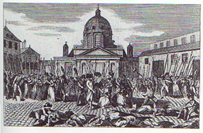
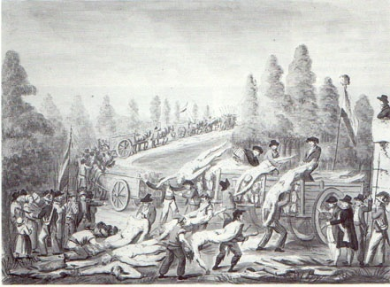
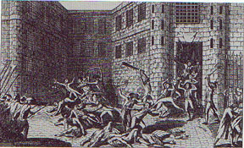
I. Downfall of the Constitution
A) Outbreaks of violence
1. 8/10/1792→ King’s guards slaughtered
2. The “September Massacres”
* Jacobins have political enemies killed
* Jacobins→ patriots or savages?

Slide 3
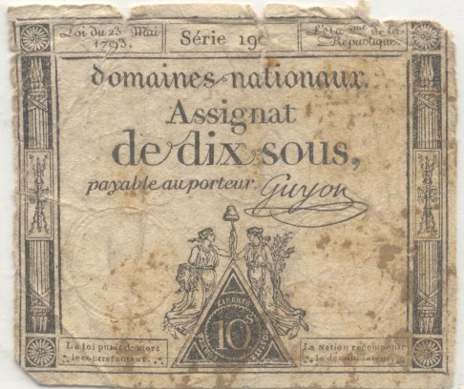
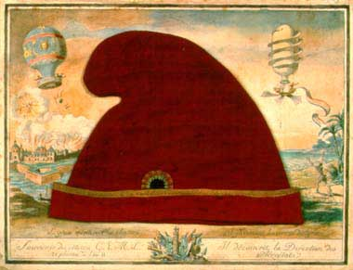
B) The French Republic
1. The Const. of 1791 is disregarded
2. Legis. Assemb. disbanded
3. National Convention formed
* Abolished the nobility (titles)
* All people given title of “Citizen”

Slide 4
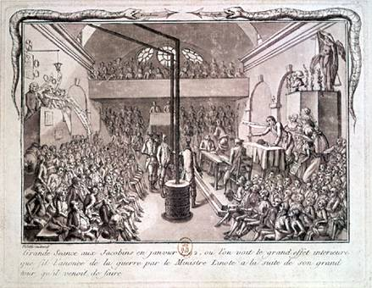
II. The Convention Under Siege
A) Rival groups fight in the Convention
1. Jacobins
2. Girondins
3. Mountain

Slide 5
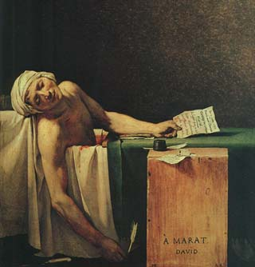
B) Jacobins form the Committee of Public Safety
1. Deal with threats to France
2. 12 men
3. Send armies to invade Netherlands, Italy, etc.
4. Crush opposition at home

Slide 6
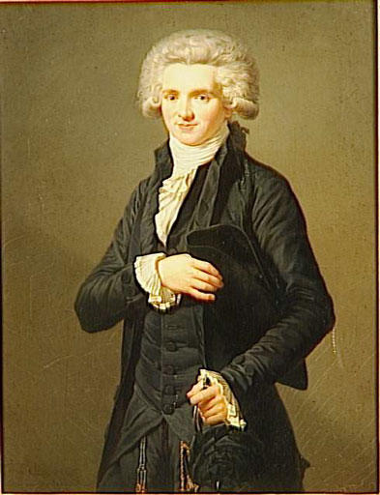
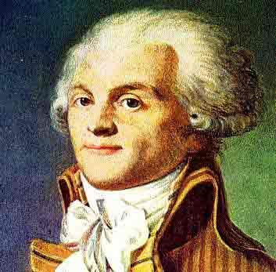
C) Maximillian Robespierre→ lawyer
1. Leader of the Committee of Public Safety
2. Outspoken, crafty politician
3. Popular with the sans culottes
4. Wants to get rid of monarchy, nobles, Church
5. Wants to get rid of anyone “anti-revolutionary”

Slide 7
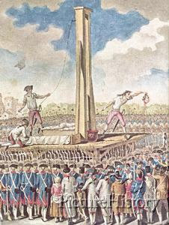
III. Reign of Terror
A) Organized by Robespierre→ create a “Republic of Virtue”
B) Hasty “show trials”→ 40,000 will die by guillotine
C) 16 and MA executed for treason

Slide 8
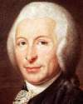
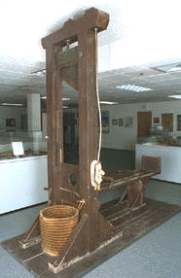
D) Plenty of mistaken ID, false accusations
E) Everyone scared of being “denounced”
F) Create new calendar and dating system→ based on seasons→ 1793 = Year 1

Slide 9
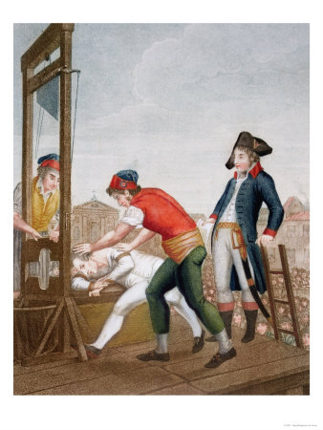
IV. Thermodorian Reaction
A) Robespierre and the CPS went to far→ become unpopular
B) On 9 Thermidor the CPS was declared illegal
C) Robespierre and others attempt to flee/suicide
D) CPS guillotined the next day.

Slide 10
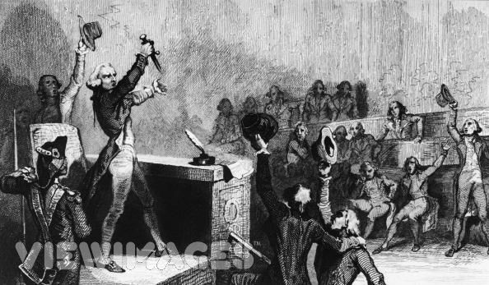
V. Reaction and the Directory
A) Constitution of 1795 written
B) The Directory is created
1. 1795-1799
2. Dictatorial but weak
3. 5 Men are “Directors”
4. Suppress riots
5. Use Napoleon Bonaparte→ popular military hero

Slide 11
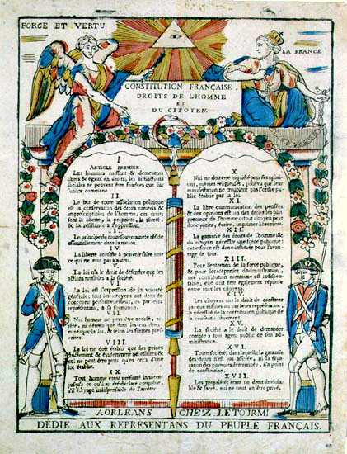
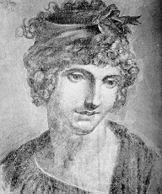
V. Women in the Revolution
A) Declaration of the Rights of Women
1. Olympia de Gouges

Slide 12
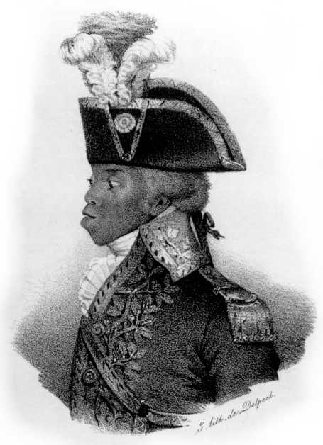
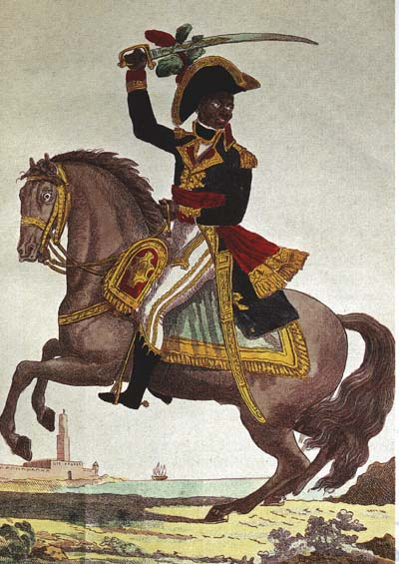
VI. Changes in Daily Life
A) In Paris→ streets, buildings, names all different
B) Nationalism—an aggressive feeling of pride and devotion to ones country
1. la Marseilles → French national anthem
C) Social reform
1. Mandatory elementary education
2. Care provided for poor, old, widows
3. Slavery banned
4. More rights for all

